Slide 1
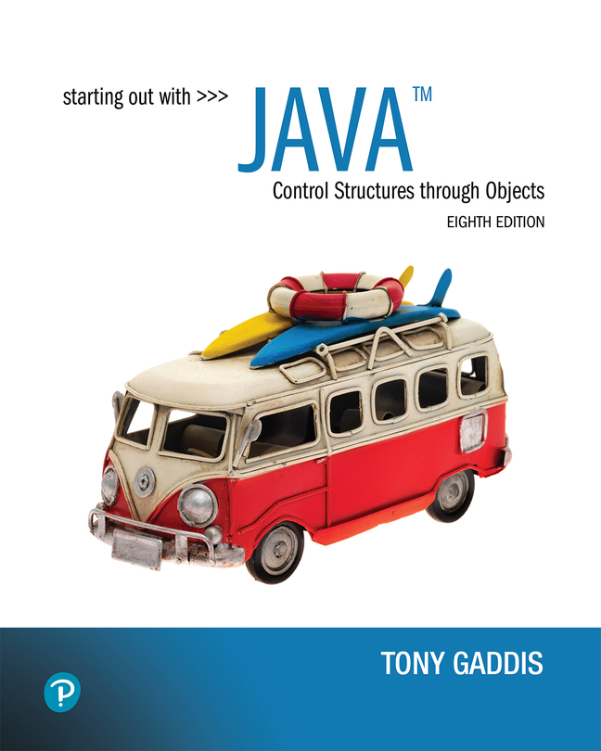

Starting Out with Java Control Structures Through Objects
Eighth Edition
Chapter 9
Text Processing and Wrapper Classes
Copyright © 2022 Pearson Education, Inc. All Rights Reserved
Notes:
If this PowerPoint presentation contains mathematical equations, you may need to check that your computer has the following installed:
1) MathType Plugin
2) Math Player (free versions available)
3) NVDA Reader (free versions available)

Slide 2
Chapter Topics
Chapter 9 discusses the following main topics:
Introduction to Wrapper Classes
Character Testing and Conversion with the Character Class
More String Methods
The StringBuilder Class
Tokenizing Strings
Wrapper Classes for the Numeric Data Types
Focus on Problem Solving: The TestScoreReader Class

Slide 3
Introduction to Wrapper Classes
Java provides 8 primitive data types.
They are called “primitive” because they are not created from classes.
Java provides wrapper classes for all of the primitive data types.
A wrapper class is a class that is “wrapped around” a primitive data type.
The wrapper classes are part of java.lang so to use them, there is no import statement required.

Slide 4
Wrapper Classes
Wrapper classes allow you to create objects to represent a primitive.
Wrapper classes are immutable, which means that once you create an object, you cannot change the object’s value.
To get the value stored in an object you must call a method.
Wrapper classes provide static methods that are very useful

Slide 5
Character Testing and Conversion With The Character Class (1 of 2)
The Character class allows a char data type to be wrapped in an object.
The Character class provides methods that allow easy testing, processing, and conversion of character data.

Slide 6
The Character Class Static Methods (1 of 2)
boolean Character.isDigit(char ch)
Returns true if the argument passed into ch is a digit from 0 through 9. Otherwise returns false.
boolean Character.isLetter(char ch)
Returns true if the argument passed into ch is an alphabetic letter. Otherwise returns false.
boolean Character.isLetterOrDigit(char ch)
Returns true if the argument passed into ch contains a digit from 0 through 9 or an alphabetic letter. Otherwise returns false.
boolean Character.isLowerCase(char ch)
Returns true if the argument passed into ch is a lowercase letter. Otherwise returns false.

Slide 7
The Character Class Static Methods (2 of 2)
boolean Character.isUpperCase(char ch)
Returns true if the argument passed into ch is an uppercase letter. Otherwise returns false.
boolean Character.isSpaceChar(char ch)
Returns true if the argument passed into ch is a space character. Otherwise returns false.
boolean Character.isWhiteSpace(char ch)
Returns true if the argument passed into ch contains a whitespace character (a space, tab, or newline character). Otherwise returns false.

Slide 8
Character Testing and Conversion With The Character Class (2 of 2)
Example:
CharacterTest.java
CustomerNumber.java
The Character class provides two methods that will change the case of a character.
boolean Character.toLowerCase(char ch)
Returns the lowercase equivalent of the argument passed into ch.
boolean Character.toUpperCase(char ch)
Returns the uppercase equivalent of the argument passed into ch.
See example: CircleArea.java

Slide 9
Detecting Empty and Blank Strings
An empty string has a length of 0, which means it contains no characters.
A blank string is either empty or contains only whitespace characters.
The String class provides methods for detecting empty and blank strings:
boolean isBlank()
Returns true if the calling string is empty (its length is 0) or it contains only whitespace characters.
boolean isEmpty()
Returns true if the length of the calling string is 0.

Slide 10
Substrings
The String class provides several methods that search for a string inside of a string.
A substring is a string that is part of another string.
Some of the substring searching methods provided by the String class:
boolean startsWith(String str)
boolean endsWith(String str)
boolean regionMatches(int start, String str, int start2, int n)
boolean regionMatches(boolean ignoreCase, int start, String str, int start2, int n)

Slide 11
Searching Strings (1 of 6)
The contains method returns true if the calling string object contains a particular substring.
String str = "chocolate ice cream"; if (str.contains("ice")) System.out.println("We have ice!");

Slide 12
Searching Strings (2 of 6)
The startsWith method determines whether a string begins with a specified substring.
String str = "Four score and seven years ago";
if (str.startsWith("Four"))
System.out.println("The string starts with Four.");
else
System.out.println("The string does not start with Four.");
str.startsWith("Four") returns true because str does begin with “Four”.
startsWith is a case sensitive comparison.

Slide 13
Searching Strings (3 of 6)
The endsWith method determines whether a string ends with a specified substring.
String str = "Four score and seven years ago";
if (str.endsWith("ago"))
System.out.println("The string ends with ago.");
else
System.out.println("The string does not end with ago.");
The endsWith method also performs a case sensitive comparison.
Example: PersonSearch.java

Slide 14
Searching Strings (4 of 6)
The String class provides methods that will if specified regions of two strings match.
regionMatches(int start, String str, int start2, int n)
returns true if the specified regions match or false if they don’t
Case sensitive comparison
regionMatches(boolean ignoreCase, int start, String str,
int start2, int n)
If ignoreCase is true, it performs case insensitive comparison

Slide 15
Searching Strings (5 of 6)
The String class also provides methods that will locate the position of a substring.
indexOf
returns the first location of a substring or character in the calling String Object.
lastIndexOf
returns the last location of a substring or character in the calling String Object.

Slide 16
Searching Strings (6 of 6)
String str = "Four score and seven years ago";
int first, last;
first = str.indexOf('r');
last = str.lastIndexOf('r');
System.out.println("The letter r first appears at "
+ "position " + first);
System.out.println("The letter r last appears at "
+ "position " + last);
String str = "and a one and a two and a three";
int position;
System.out.println("The word and appears at the "
+ "following locations.");
position = str.indexOf("and");
while (position != -1)
{
System.out.println(position);
position = str.indexOf("and", position + 1);
}

Slide 17
String Methods For Getting Character Or Substring Location (1 of 2)
See Table 9-5
Method | Description
int indexof (char ch) | Searches the calling String object for the character passed into ch. If the character is found, the position of its first occurrence is returned. Otherwise, negative 1 is returned.
int indexof (char ch, int start) | Searches the calling String object for the character passed into ch, beginning at the position passed into start and going to the end of the string. If the character is found, the position of its first occurrence is returned. Otherwise, negative 1 is returned.
int indexof (String str) | Searches the calling String object for the string passed into str. If the string is found, the beginning position of its first occurrence is returned. Otherwise, negative 1 is returned.
int indexof (String str, int start) | Searches the calling String object for the string passed into str. The search begins at the position passed into start and goes to the end of the string. If the string is found, the beginning position of its first occurrence is returned. Otherwise, negative 1 is returned.

Slide 18
String Methods For Getting Character Or Substring Location (2 of 2)
See Table 9-5 [Continued]
Method | Description
int lastindexof (char ch) | Searches the calling String object for the character passed into ch. If the character is found, the position of its last occurrence is returned. Otherwise, is returned.
int lastindexof (char ch, int start) | Searches the calling String object for the character passed into ch, beginning at the position passed into start. The search is conducted backward through the string, to position 0. If the character is found, the position of its last occurrence is returned. Otherwise, is returned.
int lastindexof (String str) | Searches the calling String object for the string passed into str. If the string is found, the beginning position of its last occurrence is returned. Otherwise, is returned.
int lastindexof (String str, int start) | Searches the calling String object for the string passed into str, beginning at the position passed into start . The search is conducted backward through the string, to position 0. If the string is found, the beginning position of its last occurrence is returned. Otherwise, is returned.

Slide 19
Extracting Substrings (1 of 2)
The String class provides methods to extract substrings in a String object.
The substring method returns a substring beginning at a start location and an optional ending location.
String fullName = "Cynthia Susan Smith";
String lastName = fullName.substring(14);
System.out.println("The full name is " + fullName);
System.out.println("The last name is " + lastName);

Slide 20
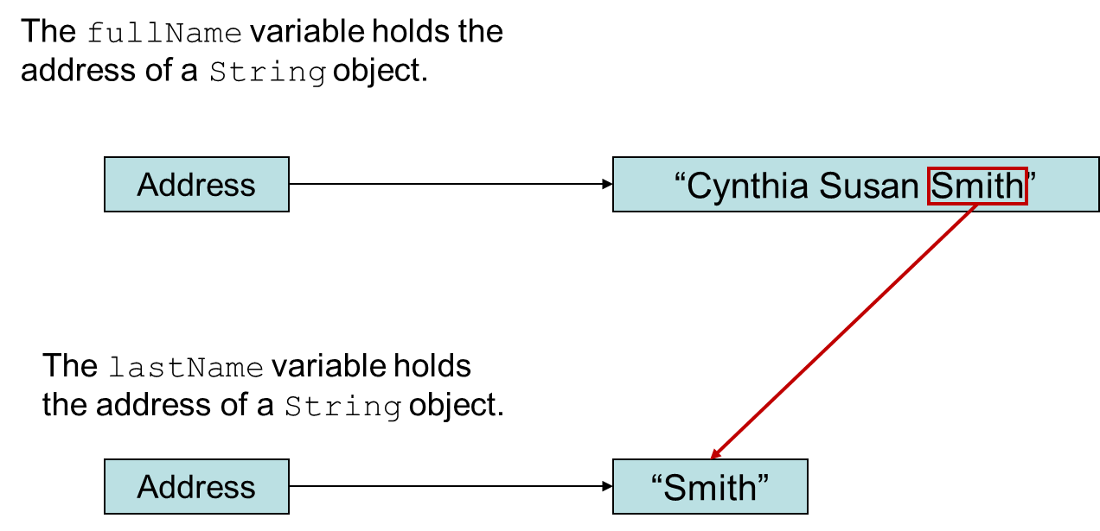
Extracting Substrings (2 of 2)
Notes:
The full name variable holds the address of a string object. An arrow from address extends to double quotes Cynthia Susan smith double quotes. The last name variable holds the address of a string object. An arrow from address extends to double quotes Smith double quotes. A highlighted arrow extends from the highlighted string object, Smith in the full name variable to the string object Smith in the last name variable.

Slide 21
Extracting Characters to Arrays
The String class provides methods to extract substrings in a String object and store them in char arrays.
getChars
Stores a substring in a char array
toCharArray
Returns the String object’s contents in an array of char values.
Example: StringAnalyzer.java

Slide 22
Manipulating Strings (1 of 3)
The String class provides methods to return modified String objects.
concat
Returns a String object that is the concatenation of two String objects.
replace
Returns a String object with all occurrences of one character being replaced by another character.

Slide 23
Manipulating Strings (2 of 3)
The String class provides methods to return modified String objects.
indent(n)
Returns a copy of the calling String object with each line's indentation adjusted.
If n is greater than 0, then n spaces will be added to the beginning of each line of the String.
If n is negative, up to n whitespace characters will be taken away from the beginning of each line of the String.
If n is equal to 0, the method returns a copy of the calling String unchanged.

Slide 24
Manipulating Strings (3 of 3)
The String class provides methods to return modified String objects.
repeat(n)
Returns a String object that contains the contents of the calling String object repeated a total of n times.
stripLeading
Returns a copy of a String object with all leading whitespace characters removed.
stripTrailing
Returns a copy of a String object with all trailing whitespace characters removed.
strip
Returns a copy of a String object with all leading and trailing whitespace characters removed.

Slide 25
Calling String Methods on String Literals
You can call String class methods on string literals.
Examples:
String str1 = "*".repeat(3);
String str2 = "x".concat("yz");
String str3 = "a".concat("bc-").repeat(3).toUpperCase();

Slide 26
TheStatic valueOf Methods
The String class provides several static overloaded valueOf methods.
They return a String object representation of
a primitive value or
a character array.
String.valueOf(true) will return "true".
String.valueOf(5.0) will return "5.0".
String.valueOf(‘C’) will return "C".

Slide 27
The valueOf Methods
boolean b = true;
char [] letters = { 'a', 'b', 'c', 'd', 'e' };
double d = 2.4981567;
int i = 7;
System.out.println(String.valueOf(b));
System.out.println(String.valueOf(letters));
System.out.println(String.valueOf(letters, 1, 3));
System.out.println(String.valueOf(d));
System.out.println(String.valueOf(i));
Produces the following output:
true
abcde
bcd
2.4981567
7

Slide 28
The StringBuilder Class
The StringBuilder class is similar to the String class.
However, you may change the contents of StringBuilder objects.
You can change specific characters,
insert characters,
delete characters, and
perform other operations.
A StringBuilder object will grow or shrink in size, as needed, to accommodate the changes.

Slide 29
StringBuilder Constructors
StringBuilder()
This constructor gives the object enough storage space to hold 16 characters.
StringBuilder(int length)
This constructor gives the object enough storage space to hold length characters.
StringBuilder(String str)
This constructor initializes the object with the string in str.
The object will have at least enough storage space to hold the string in str.

Slide 30
Other StringBuilder Methods
The String and StringBuilder also have common methods:
char charAt(int position)
void getChars(int start, int end,
char[] array, int arrayStart)
int indexOf(String str)
int indexOf(String str, int start)
int lastIndexOf(String str)
int lastIndexOf(String str, int start)
int length()
String substring(int start)
String substring(int start, int end)

Slide 31
Appending to a StringBuilder Object (1 of 4)
The StringBuilder class has several overloaded versions of a method named append.
They append a string representation of their argument to the calling object’s current contents.
The general form of the append method is:
object.append(item);
where object is an instance of the StringBuilder class and item is:
a primitive literal or variable.
a char array, or
a String literal or object.

Slide 32
Appending to a StringBuilder Object (2 of 4)
After the append method is called, a string representation of item will be appended to object’s contents.
StringBuilder str = new StringBuilder();
str.append("We sold ");
str.append(12);
str.append(" doughnuts for $");
str.append(15.95);
System.out.println(str);
This code will produce the following output:
We sold 12 doughnuts for $15.95

Slide 33
Appending to a StringBuilder Object (3 of 4)
The StringBuilder class also has several overloaded versions of a method named insert
These methods accept two arguments:
an int that specifies the position to begin insertion, and
the value to be inserted.
The value to be inserted may be
a primitive literal or variable.
a char array, or
a String literal or object.

Slide 34
Appending to a StringBuilder Object (4 of 4)
The general form of a typical call to the insert method.
object.insert(start, item);
where object is an instance of the StringBuilder class, start is the insertion location, and item is:
a primitive literal or variable.
a char array, or
a String literal or object.
Example:
Telephone.java TelephoneTester.java

Slide 35
Replacing a Substring in a StringBuilder Object (1 of 2)
The StringBuilder class has a replace method that replaces a specified substring with a string.
The general form of a call to the method:
object.replace(start, end, str);
start is an int that specifies the starting position of a substring in the calling object, and
end is an int that specifies the ending position of the substring. (The starting position is included in the substring, but the ending position is not.)
The str parameter is a String object.
After the method executes, the substring will be replaced with str.

Slide 36
Replacing a Substring in a StringBuilder Object (2 of 2)
The replace method in this code replaces the word “Chicago” with “New York”.
StringBuilder str = new StringBuilder(
"We moved from Chicago to Atlanta.");
str.replace(14, 21, "New York");
System.out.println(str);
The code will produce the following output:
We moved from New York to Atlanta.

Slide 37
Other StringBuilder Methods (1 of 2)
The StringBuilder class also provides methods to set and delete characters in an object.
StringBuilder str = new StringBuilder(
"I ate 100 blueberries!");
// Display the StringBuilder object.
System.out.println(str);
// Delete the '0'.
str.deleteCharAt(8);
// Delete "blue".
str.delete(9, 13);
// Display the StringBuilder object.
System.out.println(str);
// Change the '1' to '5'
str.setCharAt(6, '5');
// Display the StringBuilder object.
System.out.println(str);

Slide 38
Other StringBuilder Methods (2 of 2)
The toString method
You can call a StringBuilder's toString method to convert that StringBuilder object to a regular String
StringBuilder strb = new StringBuilder("This is a test.");
String str = strb.toString();

Slide 39
Tokenizing Strings
Use the String class’s split method
Tokenizes a String object and returns an array of String objects
Each array element is one token.
// Create a String to tokenize.
String str = "one two three four";
// Get the tokens from the string.
String[] tokens = str.split(" ");
// Display each token.
for (String s : tokens)
System.out.println(s);
This code will produce the following output:
one
two
three
four

Slide 40
Numeric Data Type Wrappers
Java provides wrapper classes for all of the primitive data types.
The numeric primitive wrapper classes are:
Wrapper Class | Numeric Primitive Type It Applies To
Byte | byte
Double | double
Float | float
Integer | int
Long | long
Short | short

Slide 41
Creating a Wrapper Object
To create objects from these wrapper classes, you can pass a value to the constructor:
Integer number = new Integer(7);
You can also assign a primitive value to a wrapper class object:
Integer number;
number = 7;

Slide 42
The toString Methods
Each of the numeric wrapper classes has a static toString method that converts a number to a string.
The method accepts the number as its argument and returns a string representation of that number.
int i = 12;
double d = 14.95;
String str1 = Integer.toString(i);
String str2 = Double.toString(d);

Slide 43
The toBinaryString, toHexString, and toOctalString Methods
The Integer and Long classes have three additional methods:
toBinaryString, toHexString, and toOctalString
int number = 14;
System.out.println(Integer.toBinaryString(number));
System.out.println(Integer.toHexString(number));
System.out.println(Integer.toOctalString(number));
This code will produce the following output:
1110
e
16

Slide 44
The Parse Methods (1 of 2)
Any string containing a number, such as “127.89”, can be converted to a numeric data type.
Each of the numeric wrapper classes has a static method that converts a string to a number.
The Integer class has a method that converts a String to an int,
The Double class has a method that converts a String to a double,
etc.
These methods are known as parse methods because their names begin with the word “parse.”

Slide 45
The Parse Methods (2 of 2)
// Store 1 in bVar.
byte bVar = Byte.parseByte("1");
// Store 2599 in iVar.
int iVar = Integer.parseInt("2599");
// Store 10 in sVar.
short sVar = Short.parseShort("10");
// Store 15908 in lVar.
long lVar = Long.parseLong("15908");
// Store 12.3 in fVar.
float fVar = Float.parseFloat("12.3");
// Store 7945.6 in dVar.
double dVar = Double.parseDouble("7945.6");
The parse methods all throw a NumberFormatException if the String object does not represent a numeric value.

Slide 46
MIN_VALUE and MAX_VALUE
The numeric wrapper classes each have a set of static final variables
MIN_VALUE and
MAX_VALUE.
These variables hold the minimum and maximum values for a particular data type.
System.out.println("The minimum value for an "
+ "int is "
+ Integer.MIN_VALUE);
System.out.println("The maximum value for an "
+ "int is "
+ Integer.MAX_VALUE);

Slide 47
Autoboxing and Unboxing (1 of 2)
You can declare a wrapper class variable and assign a value:
Integer number;
number = 7;
You nay think this is an error, but because number is a wrapper class variable, autoboxing occurs.
Unboxing does the opposite with wrapper class variables:
Integer myInt = 5; // Autoboxes the value 5
int primitiveNumber;
primitiveNumber = myInt; // unboxing

Slide 48
Autoboxing and Unboxing (2 of 2)
You rarely need to declare numeric wrapper class objects, but they can be useful when you need to work with primitives in a context where primitives are not permitted
Recall the ArrayList class, which works only with objects.
ArrayList<int> list = new ArrayList<int>(); // Error!
ArrayList<Integer> list = new ArrayList<Integer>(); // OK!
Autoboxing and unboxing allow you to conveniently use ArrayLists with primitives.

Slide 49
Problem Solving
Dr. Harrison keeps student scores in an Excel file. This can be exported as a comma separated text file. Each student’s data will be on one line. We want to write a Java program that will find the average for each student. (The number of students changes each year.)
Solution: TestScoreReader.java, TestAverages.java

Slide 50

Copyright
This work is protected by United States copyright laws and is provided solely for the use of instructors in teaching their courses and assessing student learning. Dissemination or sale of any part of this work (including on the World Wide Web) will destroy the integrity of the work and is not permitted. The work and materials from it should never be made available to students except by instructors using the accompanying text in their classes. All recipients of this work are expected to abide by these restrictions and to honor the intended pedagogical purposes and the needs of other instructors who rely on these materials.

